Slide 1
Addressing the Network – IPv4
Dr. Muazzam A. Khan

Slide 2
Objectives
Explain the structure IP addressing and demonstrate the ability to convert between 8-bit binary and decimal numbers.
Given an IPv4 address, classify by type and describe how it is used in the network.
Explain how addresses are assigned to networks by ISPs and within networks by administrators.
Determine the network portion of the host address and explain the role of the subnet mask in dividing networks.
Given IPv4 addressing information and design criteria, calculate the appropriate addressing components.

Slide 3
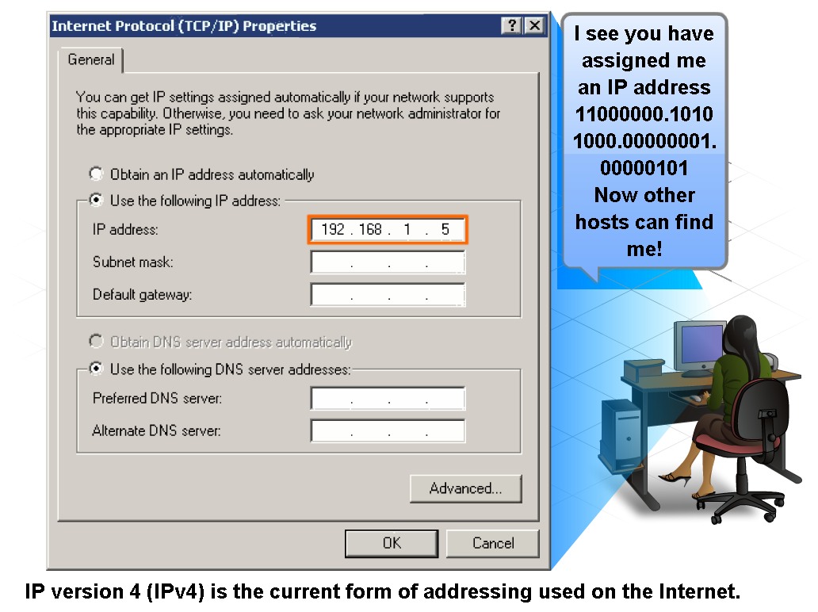
IP Addressing Structure
Describe an octet, network portion, host portion

Slide 4
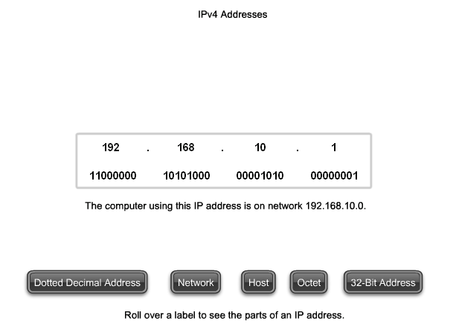
IP Addressing Structure
Describe these parts of an IPv4 address. Total of 32 bits long!

Slide 5
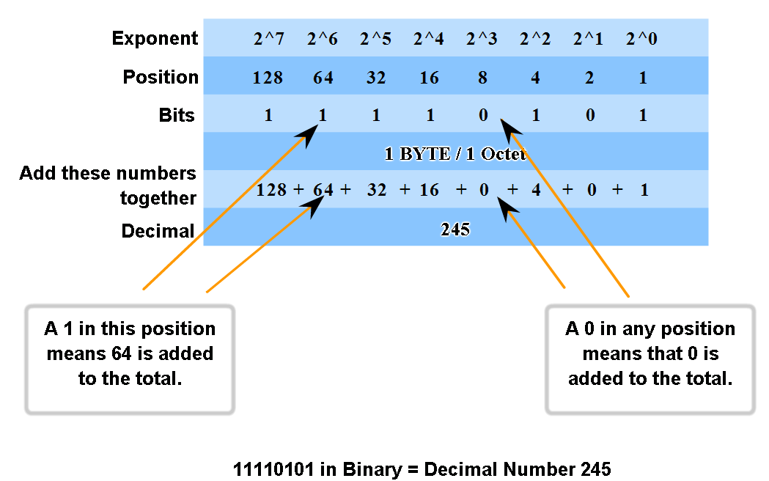
IP Addressing Structure
Practice converting 8-bit binary to decimal –

Slide 6
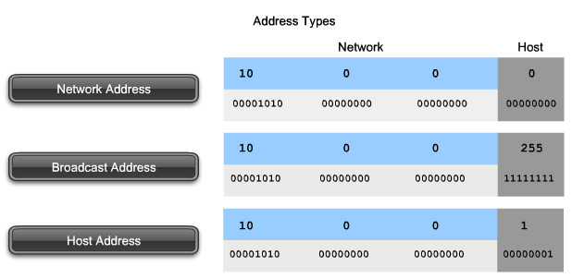
Classify and Define IPv4 Addresses
Name the three types of addresses in the network and describe the purpose of each type

Slide 7
Types of addresses
Network Address
  The network address is a standard way to refer to a network.
Broadcast
  Special address for each network that allows communication to all the hosts in that network. To send data to all hosts in a network.
Host
  Every end device requires a unique address to deliver a packet to that host. In IPv4 addresses, we assign the values between the network address and the broadcast address to the devices in that network.

Slide 8
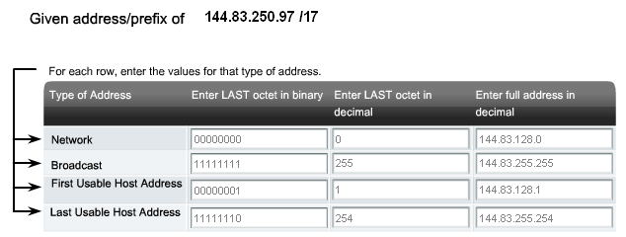
Classify and Define IPv4 Addresses
Determine the network, broadcast and host addresses for a given address and prefix combination – practice this…online curriculum section 6.2.2

Slide 9
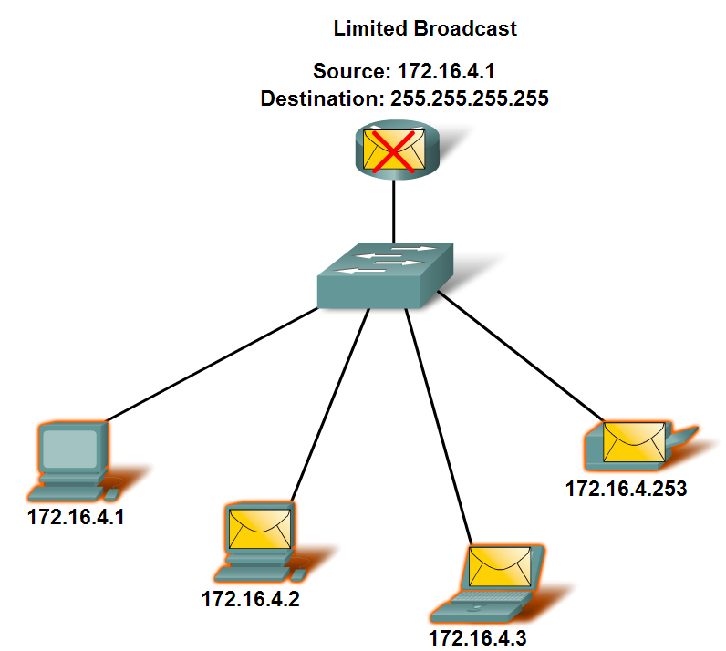
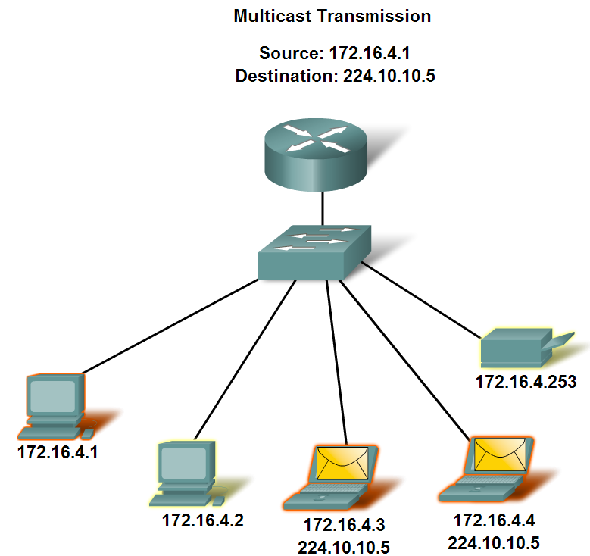
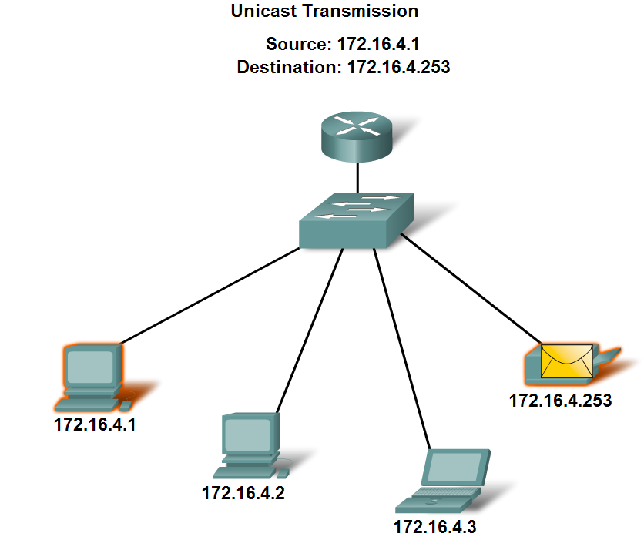
Classify and Define IPv4 Addresses
Name the three types of communication in the Network Layer and describe the characteristics of each type

Slide 10
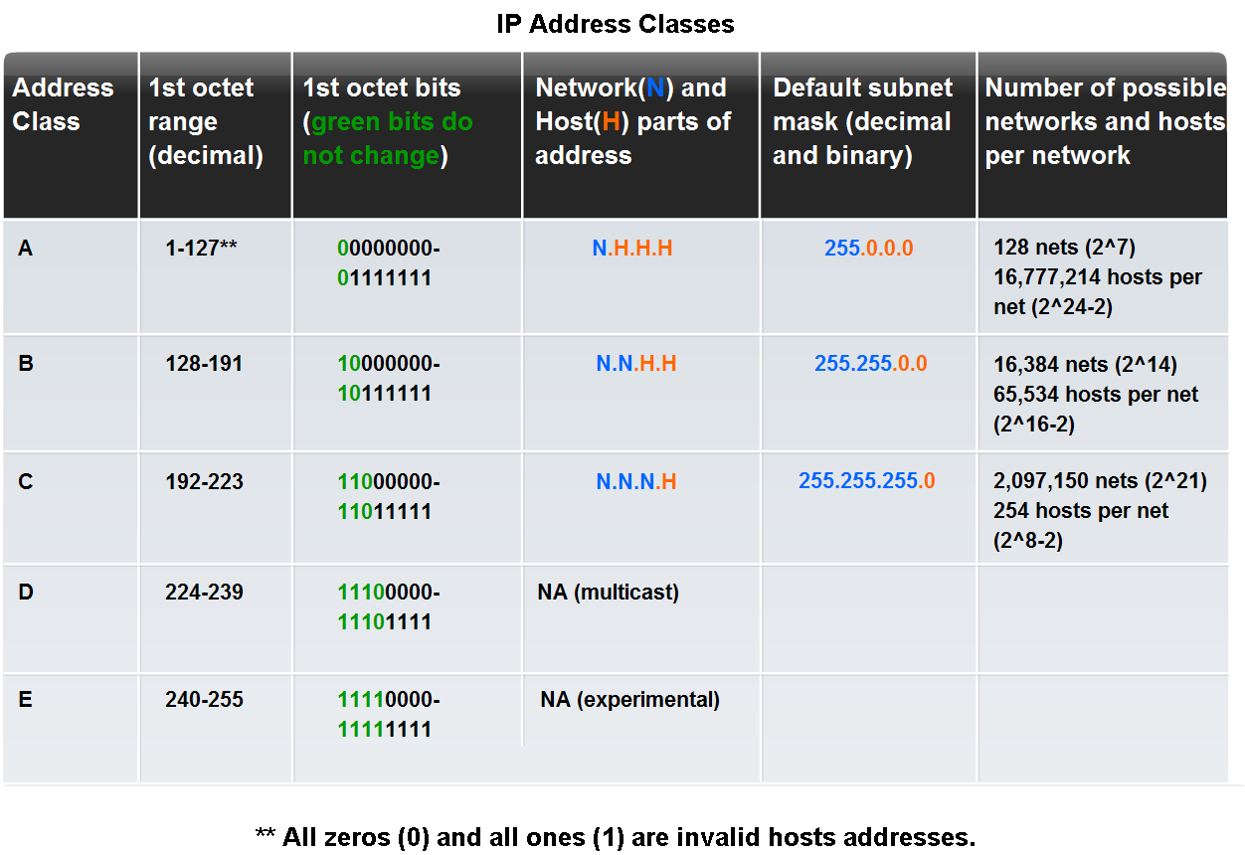
Classify and Define IPv4 Addresses

Slide 11
Classful Addressing
Class A – designed to support extremely large networks with more than 16 million host addresses.
Class B – designed to support the needs of moderate to large size networks with more than 65,000 hosts
Class C – the most commonly available of the historic address classes. This address space was intended to provide addresses for small networks with a maximum of 254 hosts.
Class D – Multicasting
Class E – Experimental

Slide 12
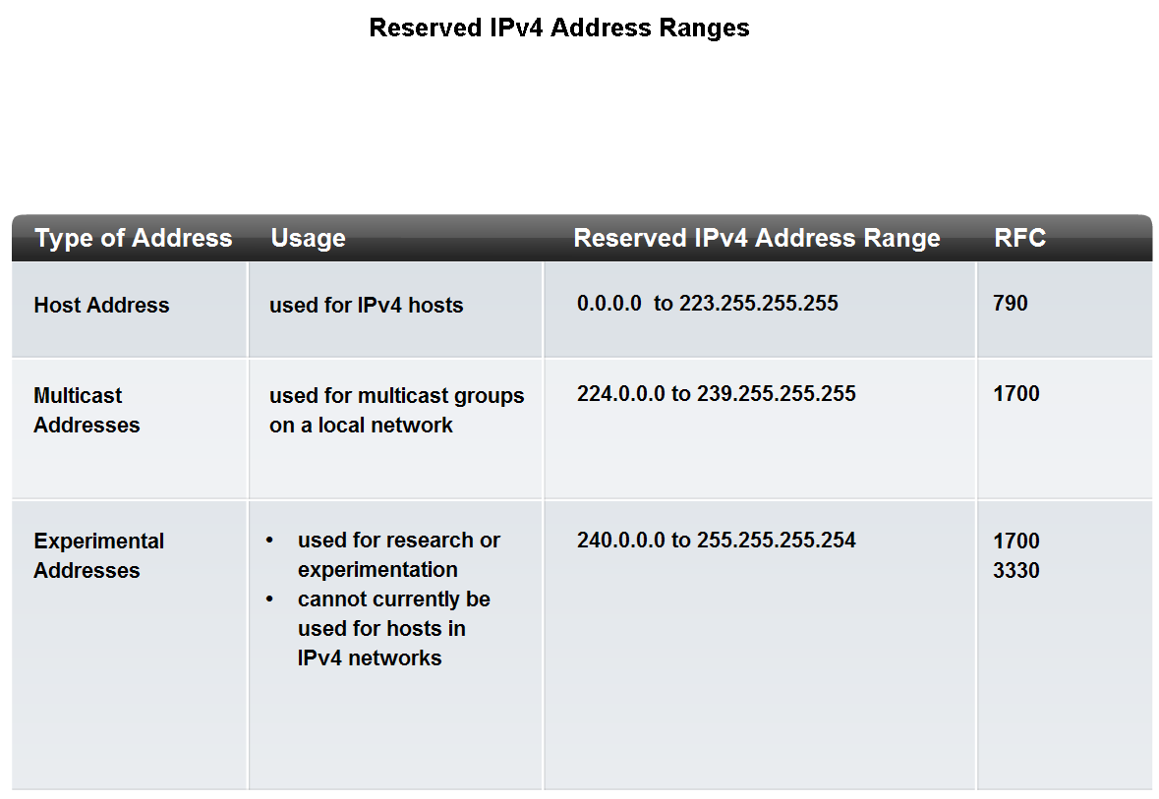
Classify and Define IPv4 Addresses
Identify the address ranges reserved for these special purposes in the IPv4 protocol

Slide 13
Special IP Addresses – can’t be assigned!
None of these addresses will be forwarded by a router and most can’t be assigned to a device (Link-local & Test-Net are the exception to that rule)
  Network Address – FIRST address of any network
  Broadcast Address – LAST address of any network
  Default Route – 0.0.0.0 – 0.255.255.255 – ‘catch-all’ route when a specific route is NOT available
  Loopback Addresses – 127.0.0.1 – 127.255.255.255 – used to test the configuration of TCP/IP on the local host (your NIC)

Slide 14
Private addressing
A private IP address is an IP address that's reserved for internal use behind a router or other Network Address Translation (NAT) device, apart from the public.
The private address blocks are:
Class A - 10.0.0.0 to 10.255.255.255
Class B - 172.16.0.0 to 172.31.255.255
Class C - 192.168.0.0 to 192.168.255.255

Slide 15
Public addressing
The remaining addresses (not in the private address block range) are designed to access the internet and carry the user wherever he/she wants to go.
Some of these addresses are designated for special purposes.

Slide 16
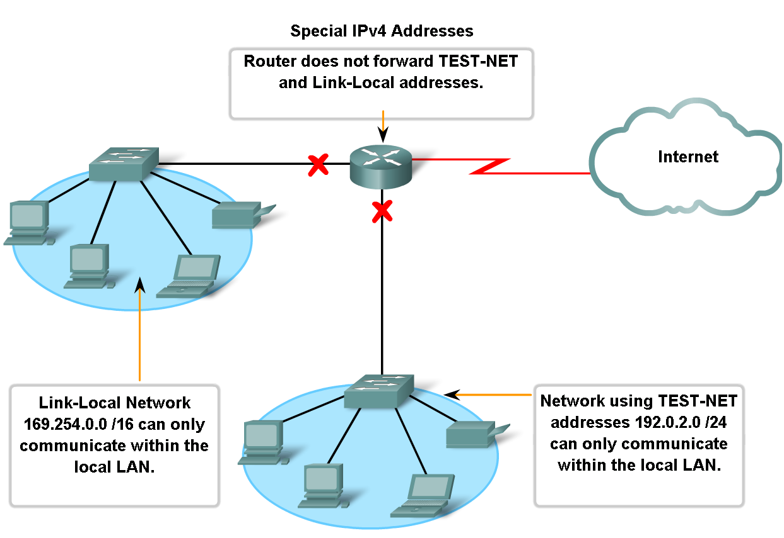
Classify and Define IPv4 Addresses

Slide 17
Limits of Classful routing
Abandoned in the 1990’s
Assumptions were made about the subnet mask based on the first octet. This is true of the OS and the routing protocols
Wasted address space
  If a company needed 260 addresses, they would have to be assigned a class B address of 65,000 addresses.

Slide 18
Planning an addressing scheme..WHY?
Preventing duplication of addresses –
Providing and controlling access –
Some devices need not only internal, but external access (servers, for example)
Monitoring security and performance - examine network traffic looking for addresses that are generating or receiving excessive packets. If we have proper planning and documentation of the network addressing, we can identify the device on the network that has a problematic address.

Slide 19
Assigning addresses
Some examples of different types of hosts are:
  End devices for users
  Servers and peripherals (static addresses, please)
  Hosts that are accessible from the Internet
  Intermediary devices (static addresses please)
Each of these different device types should be allocated to a logical block of addresses within the address range of the network.

Slide 20
Address planning..
Considerations include:
  Will there be more devices connected to the network than public addresses allocated by the network's ISP?
  Will the devices need to be accessed from outside the local network?
  If devices that may be assigned private addresses require access to the Internet, is the network capable of providing a Network Address Translation (NAT) service?

Slide 21
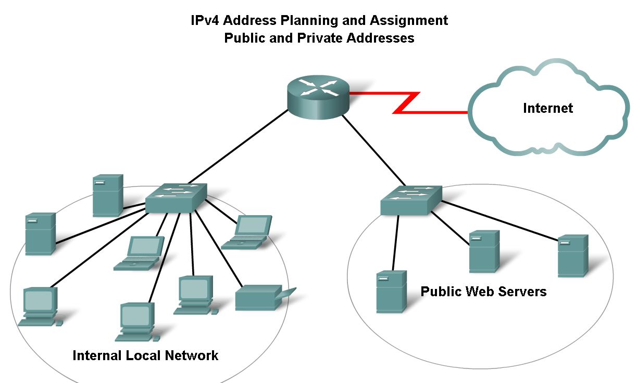
Assigning Addresses

Slide 22
Static addressing
The network administrator must manually configure the network information for a host. At a minimum, this includes entering the host IP address, subnet mask, and default gateway.
Static addresses have some advantages over dynamic addresses.
When using static IP addressing, it is necessary to maintain an accurate list of the IP address assigned to each device. These are permanent addresses and are not normally reused. Typically assigned to servers, network printers, routers, switches, etc, but NOT to PC’s (laptop or desktop)

Slide 23
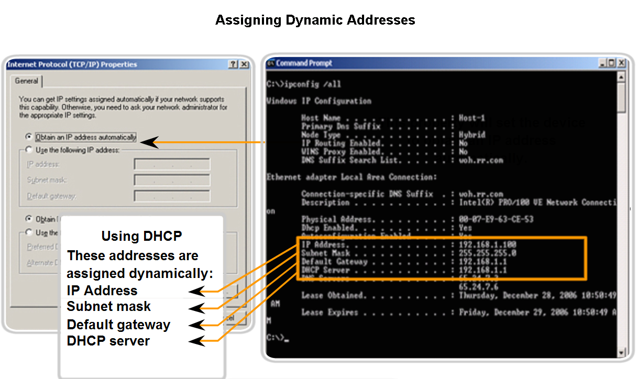
Assigning Addresses
Explain how end user devices can obtain addresses dynamically through DHCP.

Slide 24
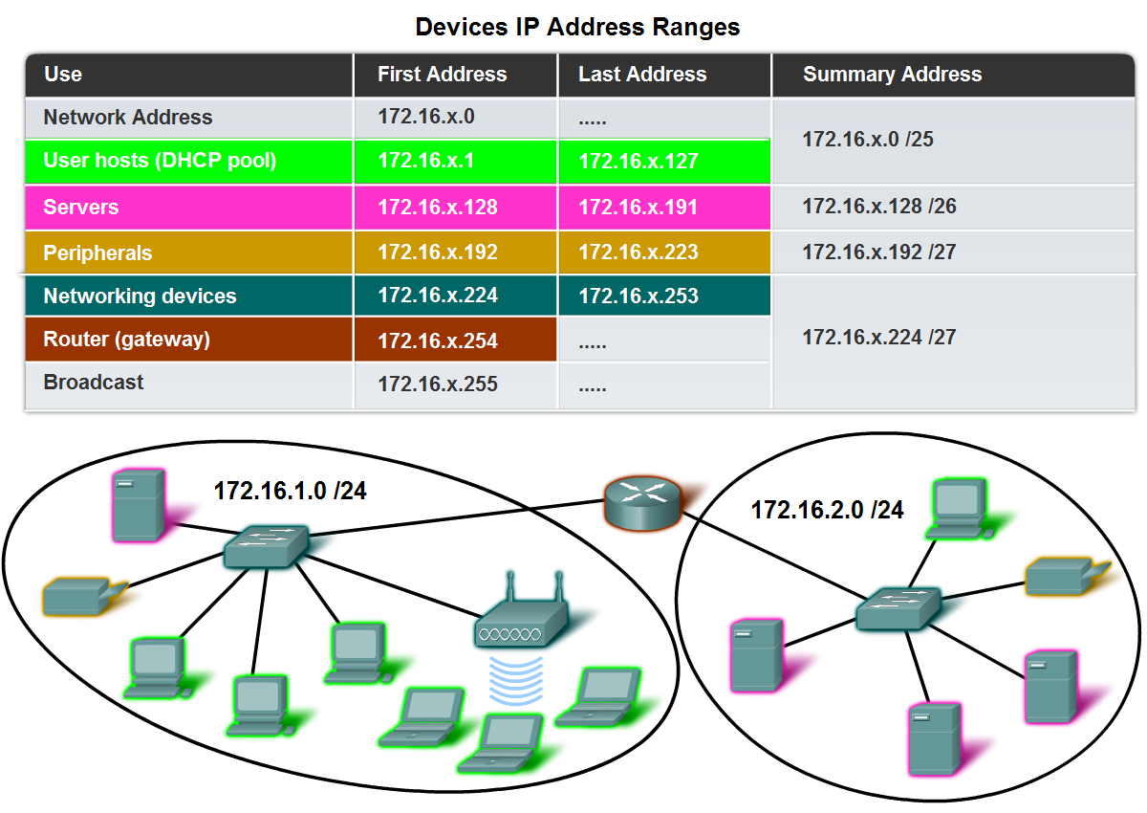
Assigning Addresses
Explain which types of addresses should be assigned to devices other than end user devices

Slide 25
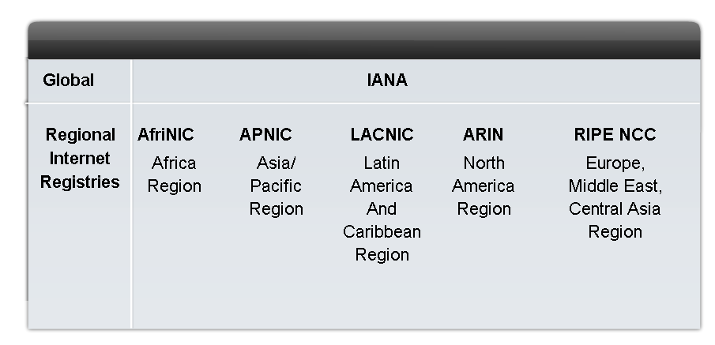
Assigning Public Addresses
IANA – Internet Assigned Numbers Authority
IANA gave these out directly until about mid-1990’s.
All remaining IPv4 were then assigned to RIR’s (Regional Internet Registries) to maintain and then to start with IPv6 addresses
ARIN is who your ISP gets its IP address blocks from.
ARIN (American Registry for Internet Numbers) - North America Region http://www.arin.net

Slide 26
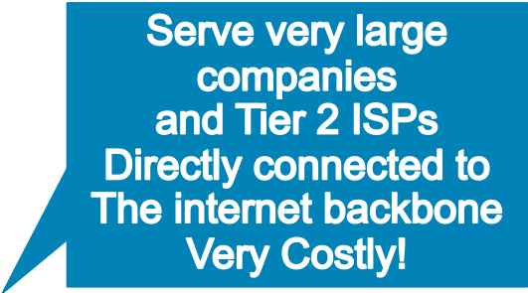
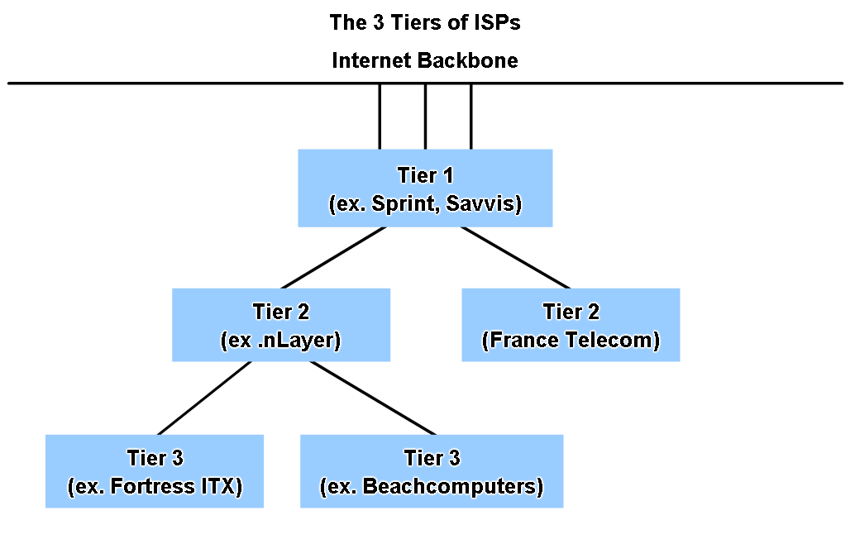
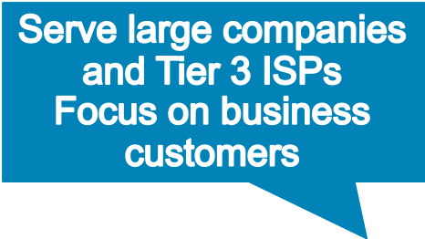

Assigning Addresses
Identify different types of ISPs and their roles in providing Internet connectivity

Slide 27
ISP’s
The farther you get from the internet backbone, services are
  Cheaper
  Less reliable
  Slower

Slide 28
IPv6 features
Larger address space
Data types and class of service updated
Uses authentication and encryption
Why was it developed?
  To give us expanded addressing capabilities!

Slide 29
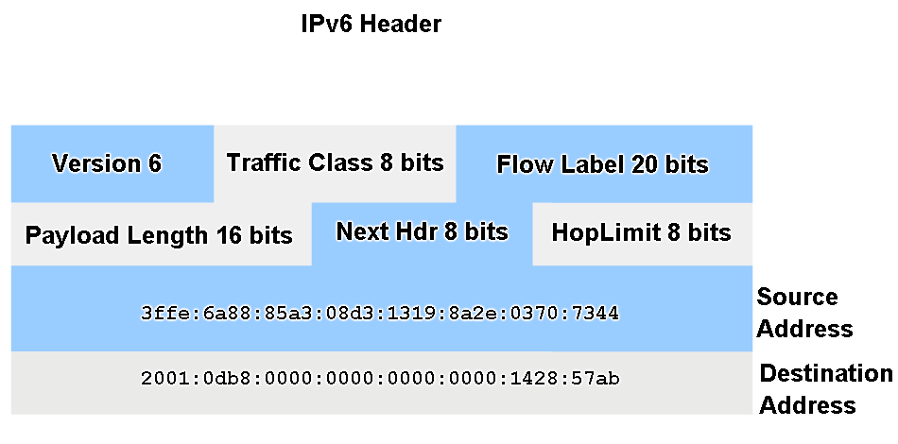
IPv6
128 bit addressing in hexadecimal #’s separated by colons
Simpler header to speed up Tx/Rx speed
Authentication and Privacy capabilities
Designed for scalability (ability to grow)

Slide 30
IPv6 continued…
IPv6 is not merely a new Layer 3 protocol - it is a new protocol suite.
New protocols at various layers of the stack have been developed to support this new protocol.
There is a new messaging protocol (ICMPv6) and new routing protocols.

Slide 31
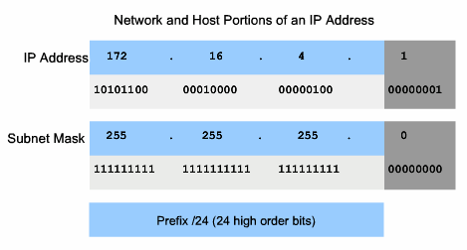
Determine the network portion of the host address and the role of the subnet mask
Network Portion – blue
SN Mask bits ALL 1’s
Host Portion – red
SN Mask bits ALL 0’s
CIDR Notation(Classless Inter Domain Routing – Prefix /24)

Slide 32
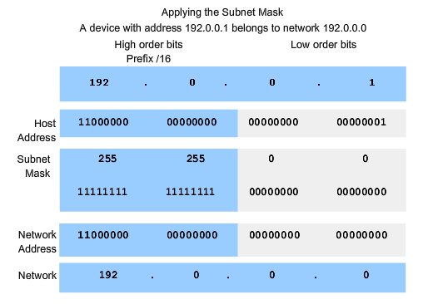
ANDing is like multiplying…convert IP and subnet mask down to binary, multiply them together..get a binary result…convert back to decimal.
This is what routers DO!!!

Slide 33
Use ANDing logic to determine an outcome

Slide 34
Calculating a Subnet
We will subnet the IP address:
  223.14.17.0
What class IP address is this?
  Class C

Slide 35
Step #1
Determine the default subnet mask
Class C default subnet mask:
  255.255.255.0

Slide 36
Step #2
Determine the number of subnets needed and hosts needed on each to determine how many bits to borrow from the host ID.
Need:
  13 subnets
  10 hosts on each subnet

Slide 37
Step #3
Figure the actual number of subnets and hosts by borrowing bits from host ID.
Let’s see how many subnets and hosts we will have by borrowing 4 bits from the host.
2^{bb}= possible subnets
2^{br} = possible hosts
2^{br} – 2 = usable hosts

Slide 38
Step #3 continued…
223.14.17.0
X X X X
H H H H
2^{bb}=16 possible subnets
2^{br}=16 possible hosts for each subnet

Slide 39
Step #3 continued…
We get 16 possible subnets and 16 possible hosts for each subnet because:
  For the 4 bits borrowed each bit can be a 1 or a 0 leaving you with 2⁴ or 16 possible combinations.
  The same goes for the 4 leftover host bits.
Important: There are only 14 available hosts on each subnet. Why?
Because you cannot use the first and last address within each subnet. (No exceptions!)
For each, one is the broadcast address and one is the network address.

Slide 40
Step #4
Determine the subnet mask.
223.14.17.0
X X X X
H H H H
Where X represents the borrowed bits for subnetting.

Slide 41
Step #4 continued…
Add the place values of X together to get the last octet decimal value of the subnet mask.
128 + 64 + 32 + 16 = 240
The subnet mask is: 255.255.255.240
The subnet mask is used to reveal the subnet and host address fields in IP addresses.

Slide 42
Step 5
Determine the ranges of host addresses for each subnet.

Slide 43
Step 5 continued…
Subnet # | Subnet Bits | Host Bits | In Decimal
1 | 0000 | 0000-1111 | .0 -.15
2 | 0001 | 0000-1111 | .16 - .31
3 | 0010 | 0000-1111 | .32 - .47
4 | 0011 | 0000-1111 | .48 - .63
5 | 0100 | 0000-1111 | .64 - .79
6 | 0101 | 0000-1111 | .80 - .95
7 | 0110 | 0000-1111 | .96 - .111
8 | 0111 | 0000-1111 | .112 - .127

Slide 44
223.14.17.0 NW IP
223.14.17.1 1st usable IP
8 +4+ 2+ 1= 15
223.14.17.14 last usable IP
1 1 1 1
223.14.17.15

Slide 45
2nd SubNetwork Host
128 64 32 16 ------ 8 4 2 1
0 0 0 1 ------ 0 0 0 0
0 0 0 1 ------ 0 0 0 1
0 0 0 1 ------ 0 0 1 1
^{3rd} SubNetwork Host
128 64 32 16 ------ 8 4 2 1
0 0 1 0 ------ 0 0 0 0
0 0 1 0 ------ 0 0 0 1

Slide 46
^{4th} SubNetwork Host
128 64 32 16 ------ 8 4 2 1
0 0 1 1 ------ 0 0 0 0
0 0 1 1 ------ 0 0 0 1
^{5th} SubNetwork Host
128 64 32 16 ------ 8 4 2 1
0 1 0 0 ------ 0 0 0 0
0 1 0 0 ------ 0 0 0 1

Slide 47
Step 5 continued…
Subnet # | Subnet Bits | Host Bits | In Decimal
9 | 1000 | 0000-1111 | .128 -.143
10 | 1001 | 0000-1111 | .144 - .159
11 | 1010 | 0000-1111 | .160 - .175
12 | 1011 | 0000-1111 | .176 - .191
13 | 1100 | 0000-1111 | .192 - .207
14 | 1101 | 0000-1111 | .208 - .223
15 | 1110 | 0000-1111 | .224 - .239
16 | 1111 | 0000-1111 | .240 - .255

Slide 48
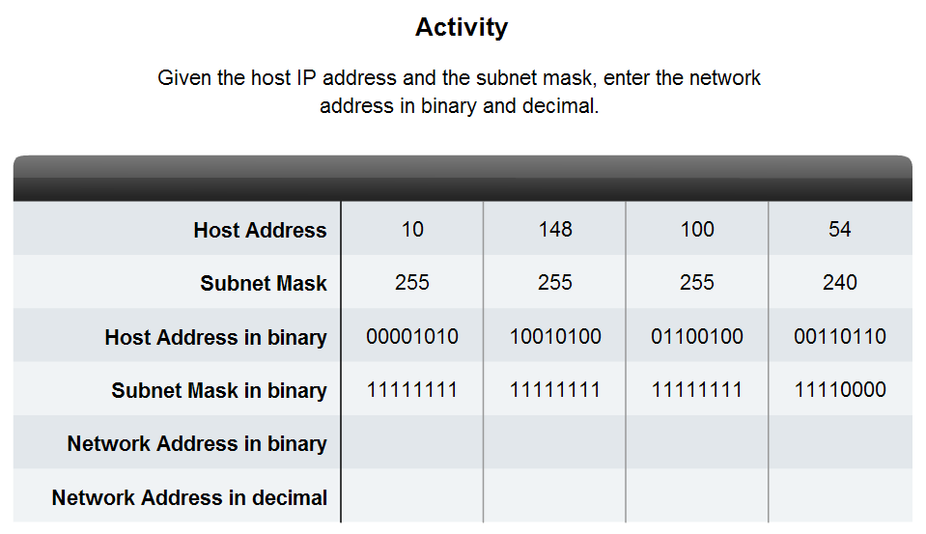
Given a subnet address and subnet mask, calculate the network address, host addresses and broadcast address (6.5.4) MUST DO THIS!

Slide 49
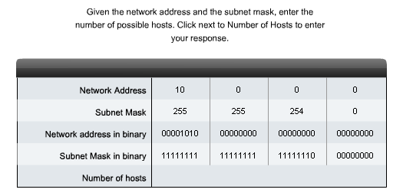
Calculating Addresses
Given a pool of addresses and masks, assign a host parameter with address, mask and gateway (6.5.5)

Slide 50
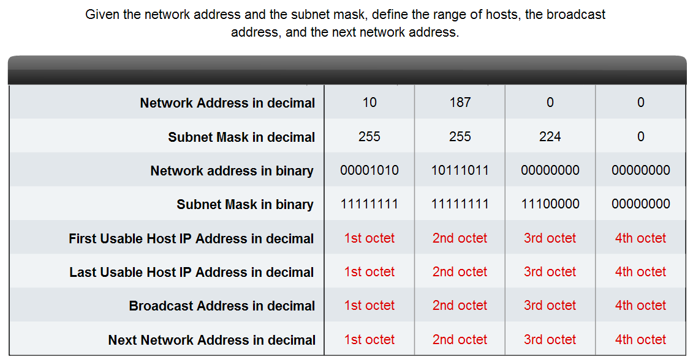
Calculating Addresses
Given a diagram of a multi-layered network, address range, number of hosts in each network and the ranges for each network, create a network scheme that assigns addressing ranges to each network (6.5.6)

Slide 51
Which one of the following are valid HOST addresses?
192.168.12.127/26
172.31.5.155/26
172.31.5.193/26
192.168.6.95/27
192.168.5.159/27
192.168.5.207/27
Be able to do this on your test!

Slide 52
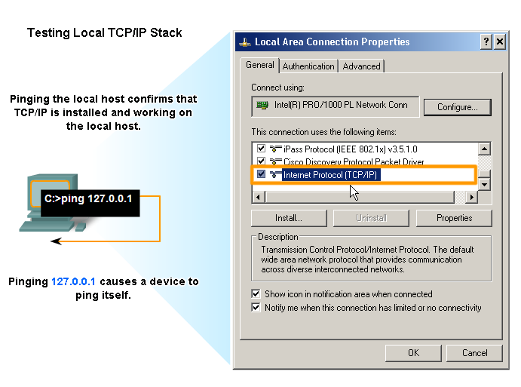
Testing the Network Layer
Use the ping command to determine if the IP protocol is operational on a local host (127.0.0.1). If this fails, TCP/IP is not properly installed on the host!

Slide 53
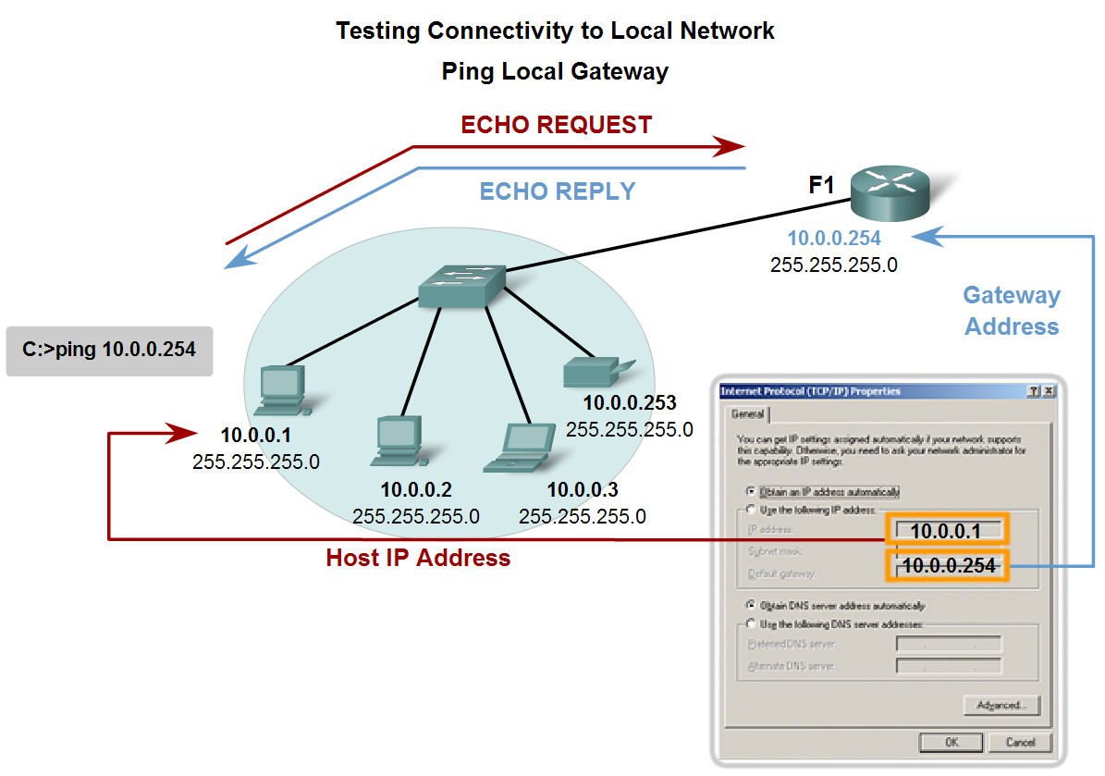
Testing the Network Layer
Use ping to verify that a local host can communicate with a gateway across a local area network

Slide 54
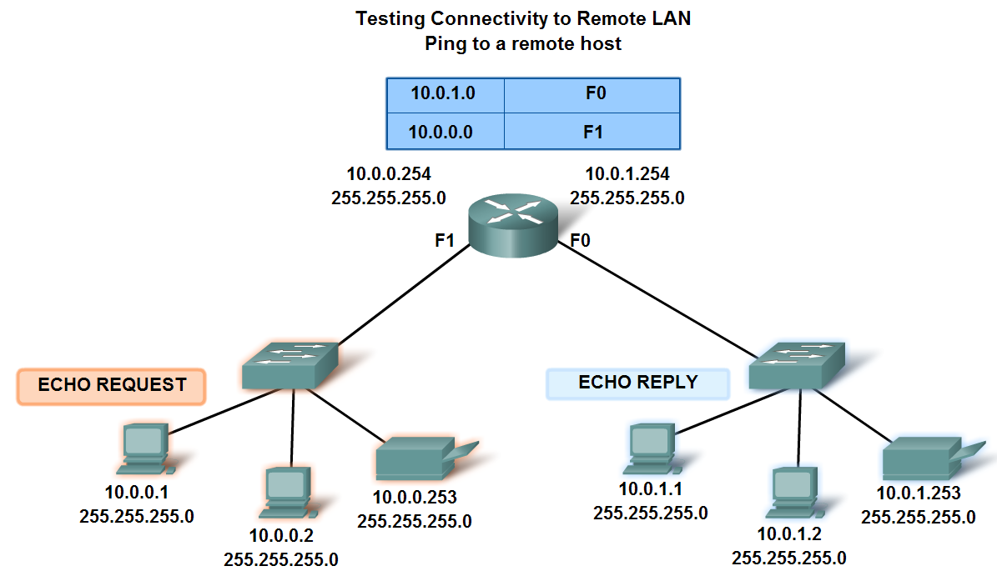
Testing the Network Layer
Use ping to verify that a local host can communicate via a gateway to a device in remote network
Remember, many network administrators limit or prohibit the entry of ICMP datagrams into the corporate network. Therefore, the lack of a ping response could be due to security restrictions.

Slide 55
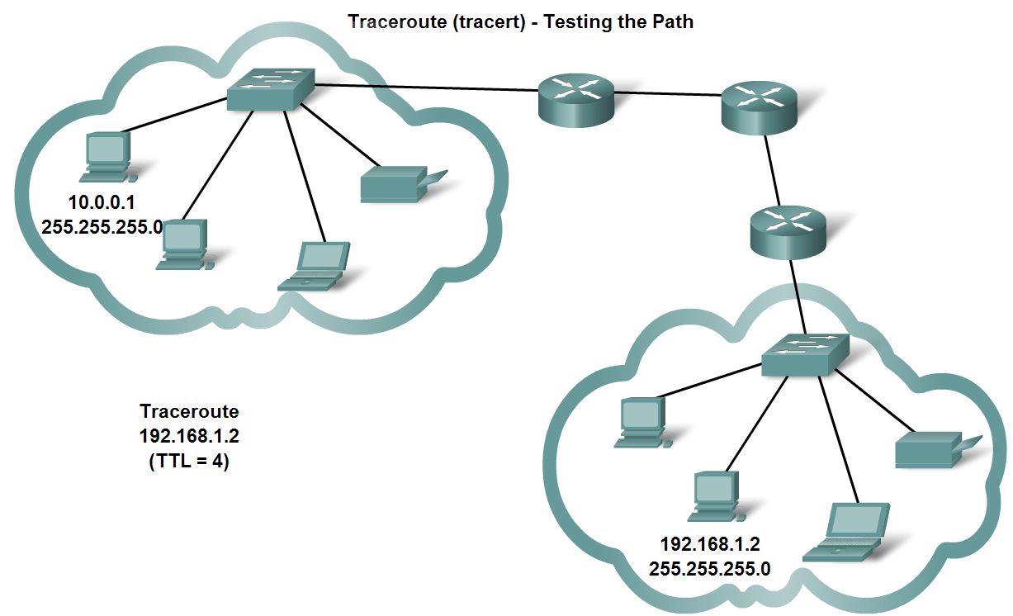
Testing the Network Layer
Use tracert/traceroute to observe the path between two devices as they communicate and trace the steps of tracert/traceroute's operation

Slide 56
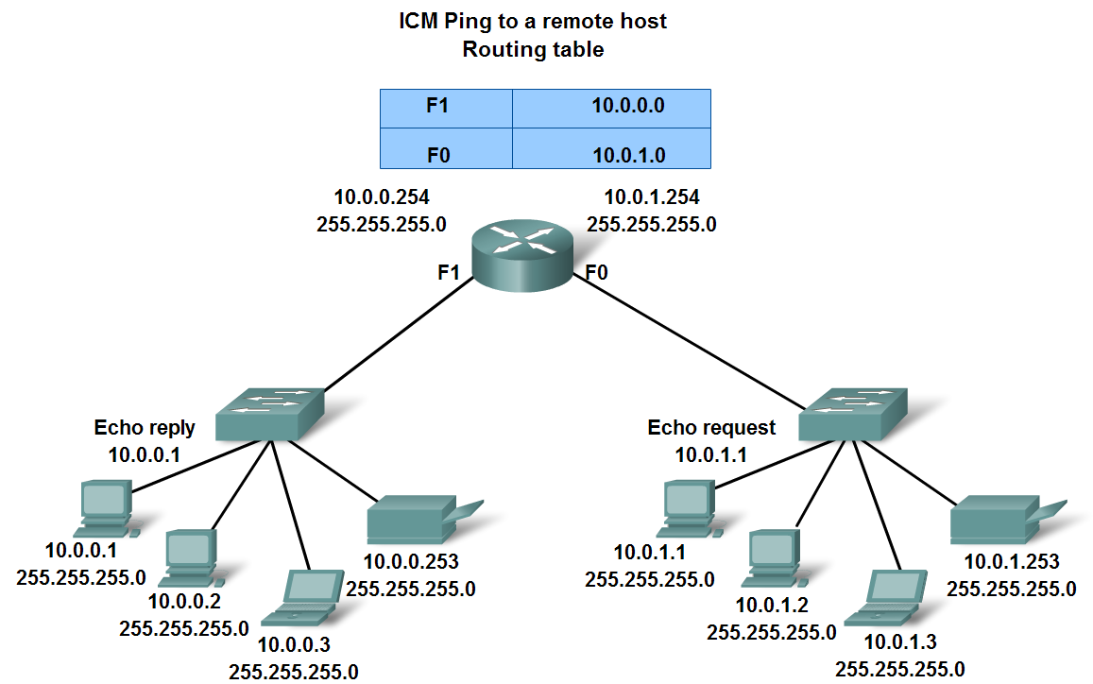
Testing the Network Layer
ICMP – provides control and error messages to the TCP/IP protocol suite.

Slide 57
ICMP messages
If the TTL mechanism expires before a packet reaches its destination, what happens?
  The router DROPS the packet
  Sends an ICMP ‘Time Exceeded’ message back to the source!

Slide 58
WOW…are you okay? Still with me? ☺
You MUST learn how to do this.
It will be part of your hands-on finals
NO CALCULATORS ALLOWED on this test or the CCNA!
Practice….Practice…… Practice….That’s the only way to get this to stick with you.
Test

